Slide 1

CAP444
OBJECT ORIENTED PROGRAMMING USING C++

Slide 2



father
mother
child

Slide 3



More examples of inheritance:
Contact List

Slide 4
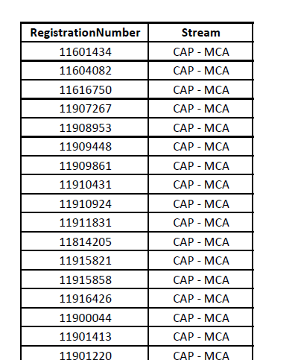
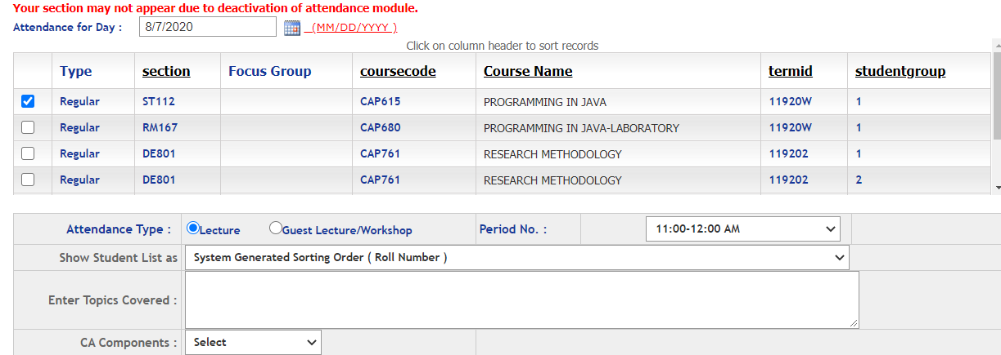
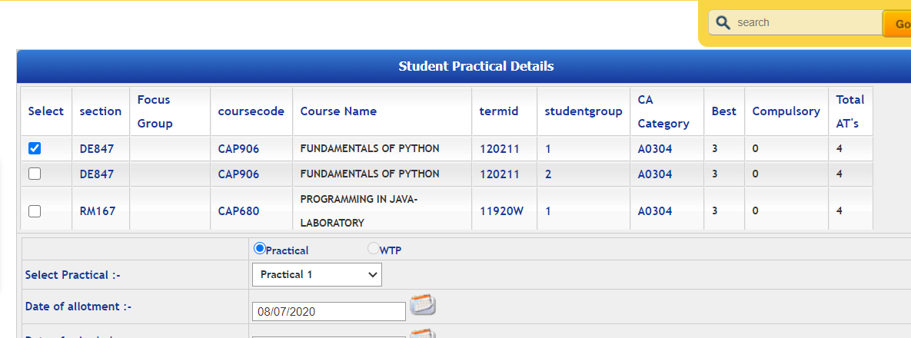
Students
More examples of inheritance:
Students in Attendance Module
Same Students in CA Module

Slide 5
Inheritance: types of inheritance
One class can hire properties from other class
Advantages: Reusability
A
A
A
B
B
B
C
C
Single
Multilevel
Multiple

Slide 6
A
A
B
C
B
C
Hierarchical Inheritance
D
Hybrid Inheritance

Slide 7
Which among the following best defines single level inheritance?
A) A class inheriting a derived class
B) A class inheriting a base class
C) A class inheriting a nested class
D) A class which gets inherited by 2 classes

Slide 8
Single inheritance:
Syntax:
class derive_class_name : access_mode base_class_name
{
//body of derive_class
};

Slide 9
Multiple Inheritance:
class derive_class_name : access_mode base_class1, access_mode base_class2, ....
{
//body of derive_class
};

Slide 10
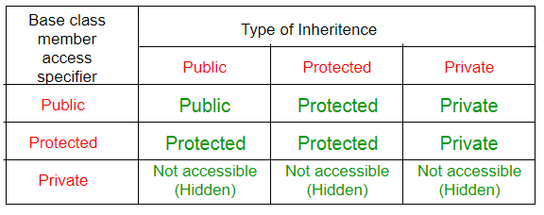
class base_class
{
//base class members (x, y)
};
class derive_class : access_Specifier base_class
{
//base class members (x, y)
//derive class members (a,b)
};

Slide 11
Which among the following is correct for a hierarchical inheritance?
a) Two base classes can be used to be derived into one single class
b) Two or more classes can be derived into one class
c) One base class can be derived into other two derived classes or more
d) One base class can be derived into only 2 classes

Slide 14
Any Query?

